Slide 1
Lecture 4
User Management
Linux Permissions

Slide 2
Topics of Lecture
User Management
Creating User Account (adduser, useradd)
Modifying User Account (usermod)
Deleting User Account (deluser, userdel)
Creating Group (addgroup, groupadd)
Modifying Group (groupmod)
Deleting Group (delgroup, groupdel)
Adding User to Group (usermod)
Removing User from Group (gpasswd)
Switch User (su)
Linux File System Access Permissions
Linux Permission Types (rwx)
Change Mode (chmod)
Change Ownership (chown)
Case Study for User Management and Linux Permissions

Slide 3
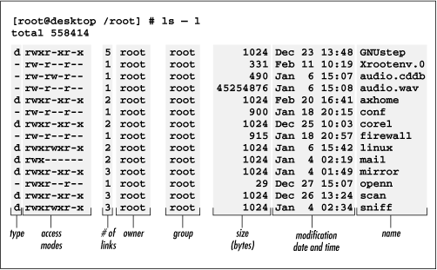
User Management/ Linux Permissions

Slide 4
User Management

Slide 5
User management
Add New User
adduser
Add user to the system according to CLI options and configuration information in /etc/adduser.conf
friendlier than useradd
set home_dir, group, uid, gid, shell for new user
useradd
Low level utility for adding users, low level means closest to raw data, to the kernel interface etc.
Syntax: $ sudo adduser [options] user
$ sudo useradd [options] user

Slide 6
User management
Add New Group
addgroup
Add group to the system according to CLI options and configuration information in /etc/adduser.conf
friendlier than groupadd
groupadd
Low level utility for adding groups
Syntax: $ sudo addgroup [options] [--gid ID] group
$ sudo groupadd [options] group

Slide 7
User management
Delete User
deluser
removes user from the system according to CLI options and configuration information in /etc/deluser.conf
userdel
Low level utility for deleting users
Syntax: $ sudo deluser [options] user
$ sudo userdel [options] user

Slide 8
User management
Delete Group
delgroup
removes group from the system according to CLI options and configuration information in /etc/deluser.conf
groupdel
Low level utility for deleting groups
Syntax: $ sudo delgroup [options] [--only-if-empty] group
$ sudo groupdel [options] group

Slide 9
User management
Modify User
usermod
It is used to modify a user account such as username, password, home directory, default shell etc.
Syntax: $ sudo usermod [options] user

Slide 10
User management
Add user to a group
$ sudo usermod -a -G groupname username
Change user's primary group
$ sudo usermod -g groupname username
Remove user from a group
$ sudo gpasswd -d username groupname

Slide 11
Switch User
su username
su [options] [-] [user [arguments...]]
su is an acronym for switch user or substitute user. You are basically switching to a particular user, and you need the password for the user you are switching to.

Slide 12
Linux Access Permissions

Slide 13
Linux Permission

Slide 14
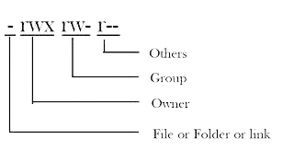
Linux permissions
There are three types of people that can do stuff to files:
User (u): Owner of the file or directory.
Group (g): Group of users added to have similar permissions.
Others (o): anyone else other than owner and the group.

Slide 15
Linux permission Types
For Files:
Read (r): Read the contents of a file.
Write (w): Write and edit the contents of a file.
Execute (x): Execute a program that is written in a file.
For directories
r allows users to list files in the directory (i.e. ls –l into it);
w means that users may delete files from the directory or move files into it;
x means the right to enter into the directory (i.e., cd into it).

Slide 16
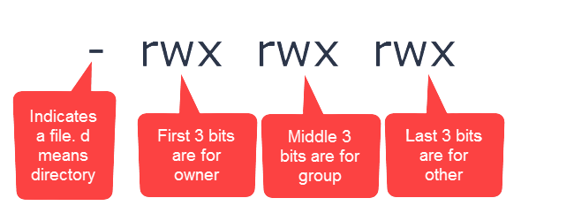
Linux permission String
10 characters in Linux Permission String
First Character is the type of the file,
The first three characters of the remaining nine characters are permissions for the user
The middle three characters are permissions for group
Last three characters are permissions for others.

Slide 17
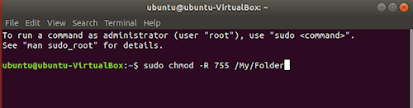
chmod - Change Mode
chmod command is used to change the permissions of a file or directory
chmod [permissions] [filename]
chmod -R [permissions] [directoryname]

Slide 18
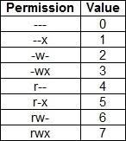
Linux permission Matrix

Slide 19
Linux permission (Symbolic)
User => u
Group => g
Others => o
All => a
read => r
write => w
execute => x
+ => add
- => remove
= => set

Slide 20
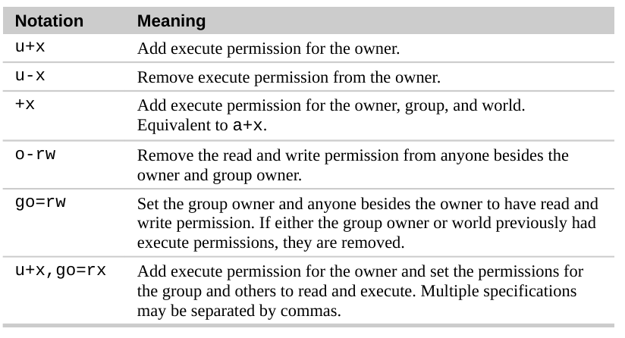
Linux permission Symbolic

Slide 21
chown - Change Ownership
chown command is used to change the ownership or group associated with a file or directory.
The value of the Owner parameter can be a user name from the user database or a numeric user ID.
Optionally, a group can also be specified. The value of the Group parameter can be a group name from the group database or a numeric group ID.
Only the root user can change the owner of a file. You can change the group of a file only if you are a root user or if you own the file.
chown [user:group] [filename]
chown -R [user:group] [directoryname]

Slide 22
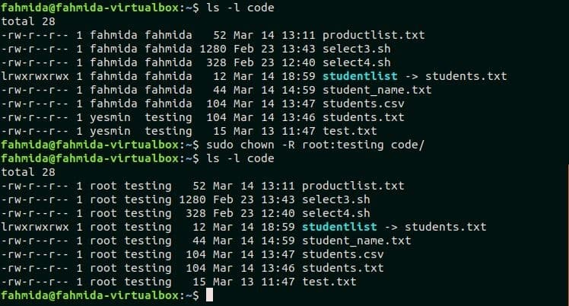
chown - Change Ownership

Slide 23
Case Study
Preform User Management and setup Linux Permissions for the following scenario:
Suppose we have four types of users working on a software project:
Team Lead (1)
Developers (2)
Code Reviewers (2)
Code Testers (2)
Setup following permissions for the above users for a software project files and directories (inside main project folder):
For team lead, only grant read/ executable permissions.
For developers, make files and directories group readable/writeable/executable.
Reviewers and testers need read/ execute access. They do not need write access.

Slide 24
Topics of Lecture
User Management
Creating User Account (adduser, useradd)
Modifying User Account (usermod)
Deleting User Account (deluser, userdel)
Creating Group (addgroup, groupadd)
Modifying Group (groupmod)
Deleting Group (delgroup, groupdel)
Adding User to Group (usermod)
Removing User from Group (gpasswd)
Switch User (su)
Linux File System Access Permissions
Linux Permission Types (rwx)
Change Mode (chmod)
Change Ownership (chown)
Case Study for User Management and Linux Permissions

Slide 25
References
https://www.elated.com/understanding-permissions/
https://www.geeksforgeeks.org/permissions-in-linux/
https://www.geeksforgeeks.org/groupmod-command-in-linux-with-examples/

